Slide 1
Contribution History Log
Slide | Contributor | Date
9-10 | Matthew | 9/28/2017
6-7 | Brandon | 9/28/2017
3-4 | Joseph | 9/28/2017
5 | Erik | 9/28/2017
8 | Kyle | 9/28/2017
11-12 | Evan | 9/28/2017

Slide 2

Brand Central
Brandon Jackson, Erik Culberson, Evan Bradley, Kyle Schrade,
Joseph Herkness, Matthew DeMott

Slide 3
User Story 1
As a user, I can register for a profile
Functional Requirements
1-6, 10
Nonfunctional Requirements
2, 4, 5

Slide 4
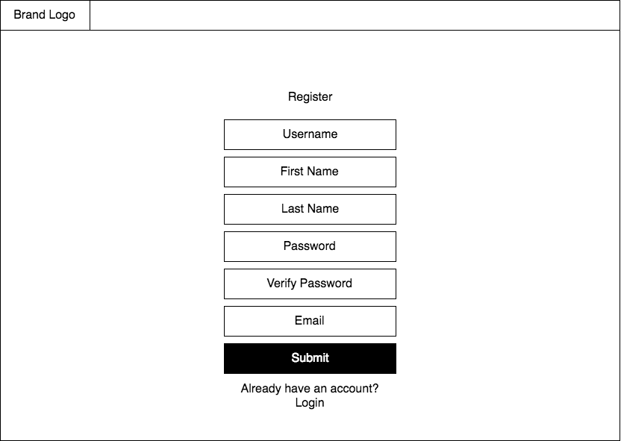
Register

Slide 5
User Story 2
As a Shopper, I can verify my email.
Functional Requirements
7-9
Nonfunctional Requirement
8

Slide 6
User Story 3
As a Shopper, I can log into my profile.
Functional Requirements
11-16
Nonfunctional Requirement
7

Slide 7
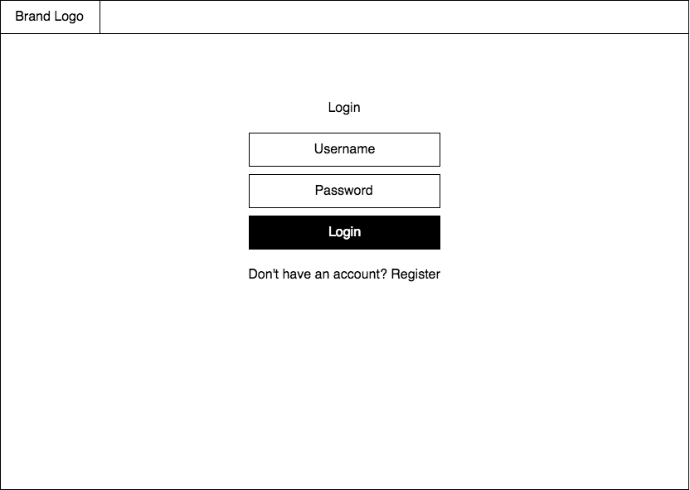
Login

Slide 8
User Story 4
As a Shopper, I can logout of my profile
Functional Requirement
17
Nonfunctional Requirement
1

Slide 9
User Story 5
As a Shopper, I can edit my profile.
Functional Requirements
18-20
Nonfunctional Requirement
5

Slide 10
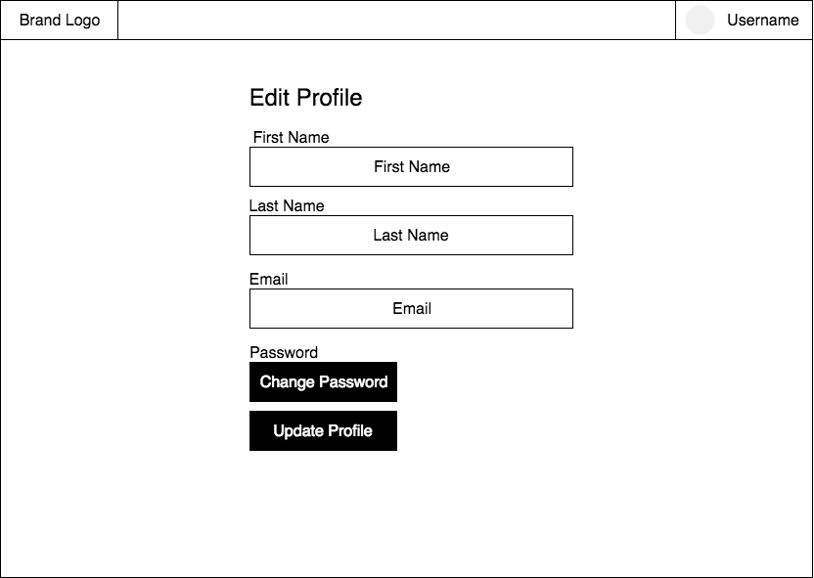
Edit Profile

Slide 11
Sprint 3 Objectives
Onboarding screen
Home screen
Scraping for data
Load product into channel
Channel view/recommendation screen
Recover password
Research and Design for machine learning

Slide 12
Demo

Slide 13
Questions

